Slide 1

Cinema Insights
Unlocking Trends in IMDb Movie Data
By- Team 1
Aru Pandey, Raktim Verma, Shiven Sharma

Slide 2
Table of Contents
Introduction
Data Overview
Data Cleaning
Key Insights
Machine Learning Models
Results
Challenges
Conclusion & Future Scope

Slide 3
Introduction
The film industry is highly competitive, and understanding what drives a movie's success is vital. Using IMDb data, this project analyzes key factors like genre, runtime, ratings, cast, and crew to uncover insights that can guide filmmakers, producers, and marketers in optimizing creative and financial decisions.

Slide 4
Business Problem
The Challenge:
The film industry faces fierce competition, with only a fraction of movies achieving critical and commercial success.
Understanding the factors driving a movie's popularity and profitability is essential for informed decision-making in production, marketing, and casting.
Objective:
Analyze data from BigQuery IMDb Dataset to uncover key elements influencing audience ratings, critical reception, and revenue.
Expected Outcome:
Provide actionable insights to filmmakers, producers, and marketers to optimize creative and financial decisions.

Slide 5
Data Overview
Dataset Source:
IMDb Public Dataset from BigQuery.
Dataset Tables:
title_basics: Movie details (genres, runtime, release year).
title_ratings: Audience ratings and average scores.
title_principals: Cast and crew information.
title_crew: Detailing the directors and writers for each movie, this table allows us to examine the impact of creative leadership and storytelling quality on audience perception.
reviews: Containing user and critic reviews, this table provides qualitative insights into audience sentiment and feedback, which is helpful for understanding broader reactions, though not essential for foundational success analysis.
totalscore_df.csv Final movie score dataset used for modeling.
revenue_df.csv Final revenue dataset used for modeling.

Slide 6
DATA CLEANING
Impactful Data Cleaning for Robust Analysis
Streamlined Data: Removed irrelevant columns like job, characters, end_year, birth_year, and death_year across key datasets to focus on core attributes, ensuring cleaner and more concise data.
Enhanced Completeness: Addressed missing values systematically:
Imputed average values for runtime_minutes to maintain consistency.
Replaced nulls in categorical fields (genres, directors, writers, etc.) with "Unknown," preserving dataset integrity.
Filled gaps in reviewer_rating with calculated mean, enhancing reliability for downstream analytics.
Prepared for Scalability: Leveraged PySpark for data cleaning, enabling seamless handling of large IMDb datasets and ensuring robust transformations across millions of records.
Outcome: Created a high-quality, well-structured foundation for advanced analysis and model building, setting the stage for meaningful insights into entertainment trends and industry dynamics.
Key Accomplishment: Proactively tackled data challenges to transform messy, inconsistent IMDb data into a clean, ready-to-analyze format, ensuring analytical accuracy and reliability.

Slide 7
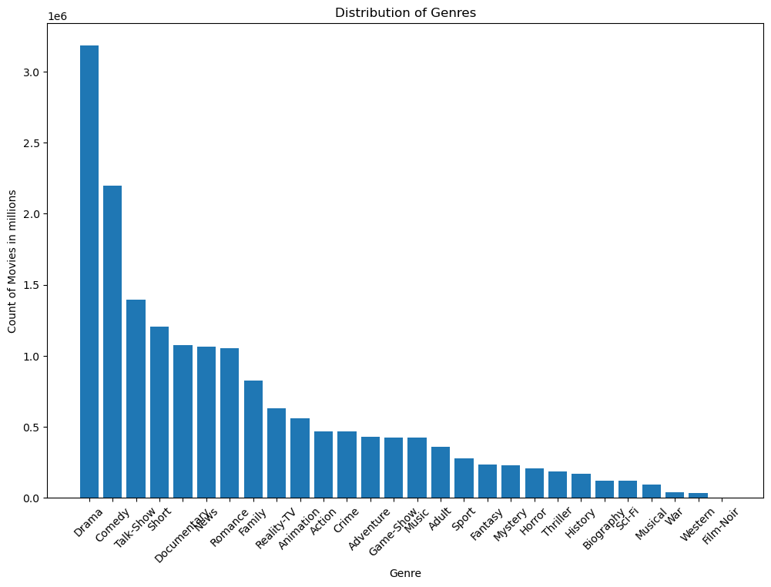
Q1. What is the distribution of genres in the dataset?
Insight: The distribution indicates that Drama and Comedy are the most common genres, reflecting broad interest and production in these areas. Specialized genres like Western and Film-Noir are significantly less common, likely due to niche audience appeal or historical popularity. This data could help guide content creators and distributors in understanding popular genres in the dataset

Slide 8
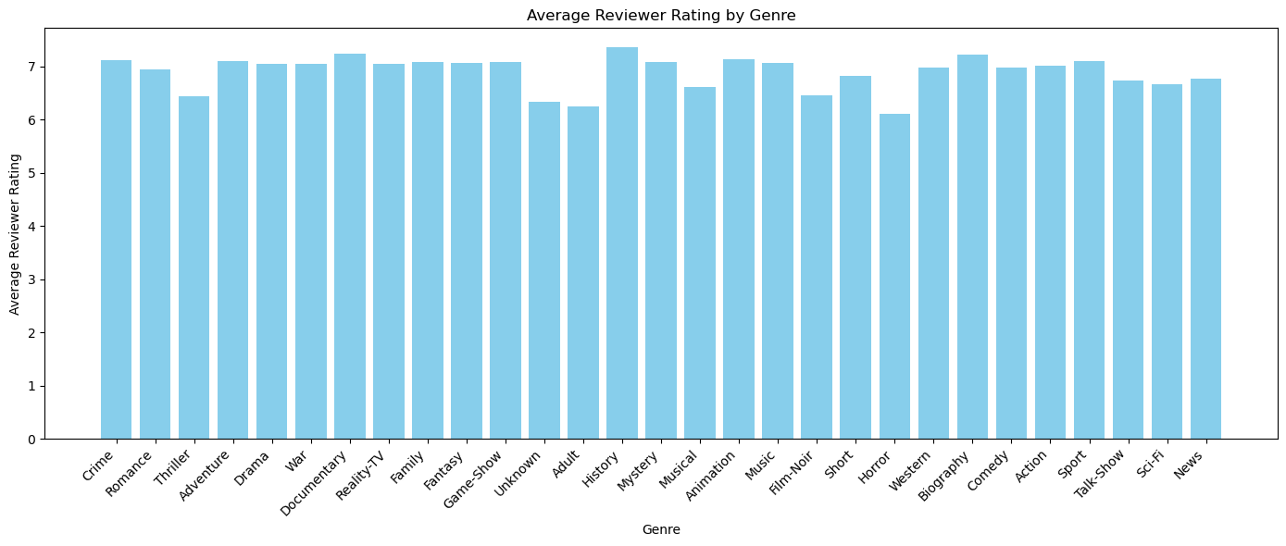
Q2. What is the average reviewer rating for each genre?
Insight: Most genres have similar average ratings (~7/10), but War, Western, Comedy, and Biography are rated slightly higher. In contrast, Horror and Reality-TV receive lower ratings, reflecting how storytelling depth or production quality impacts critical reception.

Slide 9
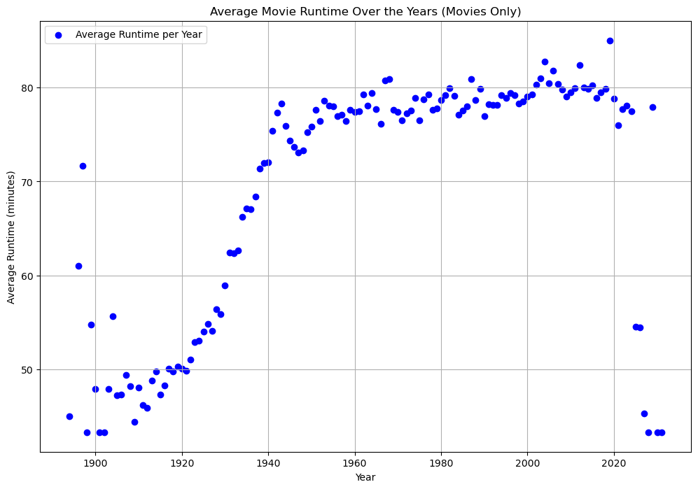
Q3. How has the average runtime of movies changed over the years?
Early 1900s:
Movies averaged ~50 minutes, reflecting technological limits and audience preferences.
1920s to 1950s:
Average runtimes grew steadily, reaching ~80 minutes by the 1950s, driven by advancements in technology and storytelling.
1960s to 1980s:
Runtimes stabilized around 80 minutes, marking the standardization of feature films.
2000s and Beyond:
Slight decrease in average runtime, likely due to diverse formats (e.g., streaming) and shifting audience preferences.
Insight:
Movie runtimes increased until the 1950s, then plateaued, with recent years showing a slight decline.

Slide 10
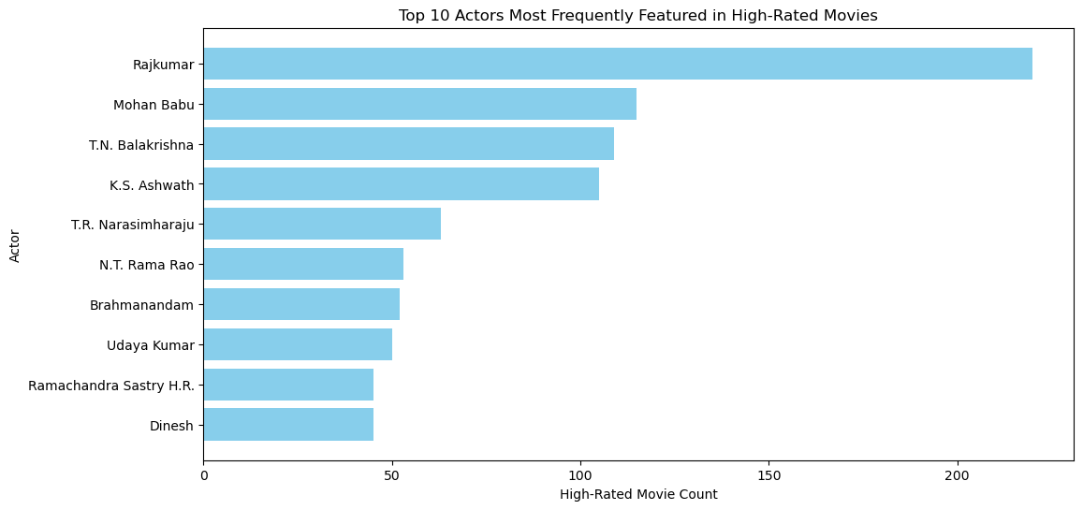
Q4.(a) Which actors are most frequently featured in high-rated films?
Top Actors with High-Rated Movies:
Rajkumar: 222 movies – A prolific career marked by widespread acclaim.
Mohan Babu: 120 movies – Consistently impactful and popular.
T.N. Balakrishna: 109 movies – A dependable presence in highly rated films.
K.S. Ashwath: 104 movies – A significant contributor to acclaimed cinema.
T.R. Narasimharaju: 62 movies – Known for distinctive roles.
Brahmanandam: 54 movies – Renowned for his contributions to quality cinema.
Insight:
These actors' strong presence in acclaimed films highlights their influence and enduring appeal in the industry.

Slide 11
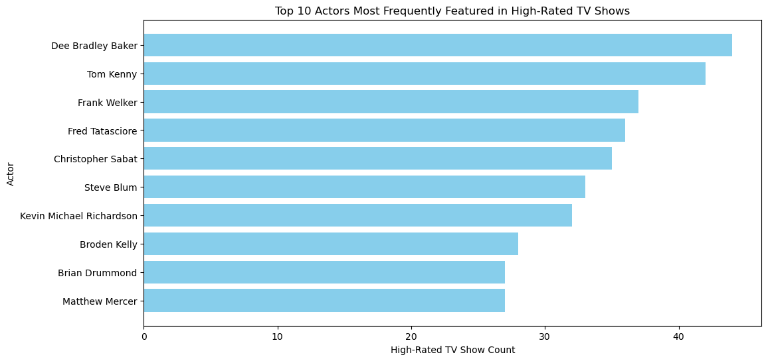
Q4.(b) Which actors are most frequently featured in high-rated TV shows?
Top Actors in Highly-Rated TV Shows:
Dee Bradley Baker: 45 shows – Renowned for versatility and audience appeal.
Tom Kenny: 42 shows – A strong influence in TV voice acting.
Frank Welker: 40 shows – Known for iconic voice roles.
Fred Tatasciore: 39 shows – A major contributor to beloved series.
Christopher Sabat: 38 shows – A consistent presence in acclaimed shows.
Steve Blum: 33 shows – Widely respected for impactful roles.
Brian Drummond: 32 shows – A notable figure in television.
Insight:
These actors excel in voice acting, consistently contributing to popular and critically acclaimed TV series.

Slide 12
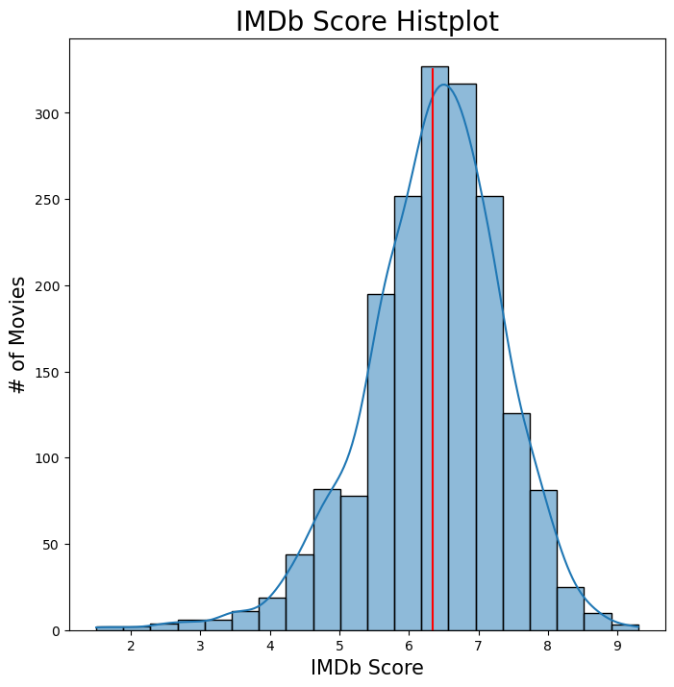
Q5. What does the distribution of IMDb scores reveal about audience reception and notable patterns?
Insight: IMDb Score Distribution
Key Observation:
IMDb scores follow a roughly normal distribution, with most movies scoring between 5 and 7.
Mean Score:
Average audience reception centers around 6, as shown by the red line in the histogram.
Conclusion:
The majority of movies receive moderate ratings, highlighting the challenge of achieving standout success.
Notes:
Actor scores are based on the average IMDb scores of movies they have previously appeared in.
Weighted by the number of votes received by those movies to ensure higher reliability for widely reviewed films.

Slide 13
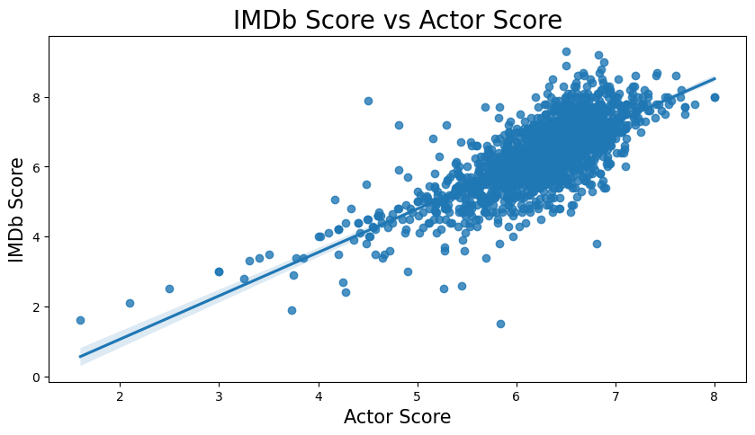
Q6. Does an Actor's Score Correlate with Movie IMDb Ratings?
Insight: Actor Scores and IMDb Ratings
Key Observation:
A positive correlation exists between actor scores and IMDb ratings.
Trend:
Movies with higher-scoring actors generally receive better audience ratings.
Conclusion:
Cast quality and popularity significantly influence a movie's success, emphasizing the importance of strategic casting decisions.
Notes:
Actor scores are based on the average IMDb scores of movies they have previously appeared in.
Weighted by the number of votes received by those movies to ensure higher reliability for widely reviewed films.

Slide 14
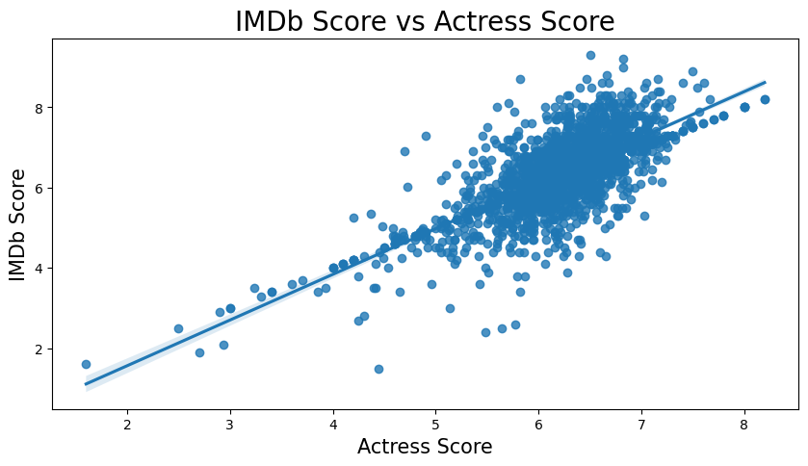
Q7: Does an Actress's Score Correlate with IMDb Ratings?
Insight: Actress Scores and IMDb Ratings
Key Observation:
A strong positive correlation exists between actress scores and IMDb ratings.
Trend:
Movies with higher-scoring actresses tend to receive better audience ratings.
Conclusion:
Leading actresses play a crucial role in shaping a movie's reception, with their popularity and acting quality driving positive audience responses.

Slide 15
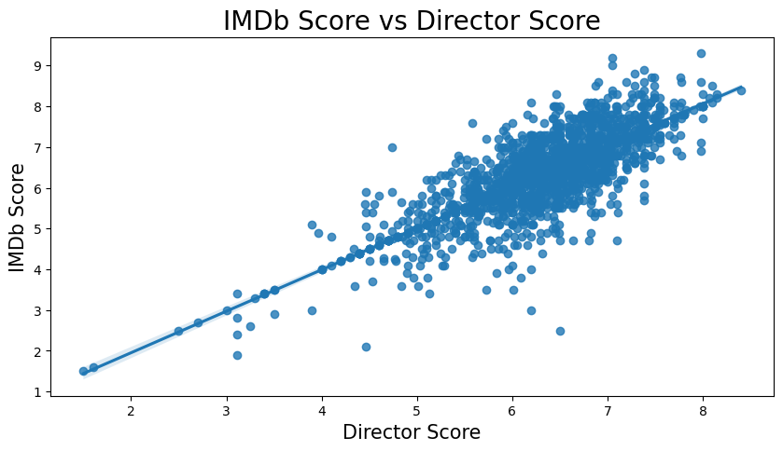
Q8: Does a Director's Score Correlate with IMDb Ratings?
Insight: Director Scores and IMDb Ratings
Key Observation:
A strong positive correlation exists between director scores and IMDb ratings.
Trend:
Movies directed by high-scoring directors typically receive better audience ratings.
Conclusion:
A director's vision, influence, and experience are pivotal in driving a movie's success, contributing significantly to audience satisfaction and critical acclaim.
Notes:
Average IMDb Ratings: The average IMDb score of movies directed by a director.

Slide 16
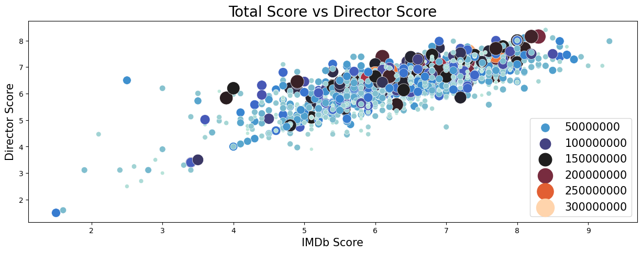
Q9. What is the correlation Between IMDb Scores, Director Scores, and Budget
Insight: IMDb Scores, Director Scores, and Budget
Key Observation:
A strong positive correlation exists between IMDb scores and director scores, with higher-rated directors producing better-rated movies.
Budget Influence:
Larger budgets (indicated by darker, larger points) are often linked to higher IMDb and director scores, amplifying the director's impact on success.
Conclusion:
Talent and financial resources work together to drive a movie's critical acclaim, highlighting the importance of balancing creative and budgetary investments.
Notes:
The total score may aggregate multiple factors such as:
IMDb Score as the base rating.
Actor, Actress, and Director Scores.
Weighted contributions from metrics like:
Sentiments (plot_sentiment, tagline_sentiment).
Box office performance (revenue, profitable).

Slide 17
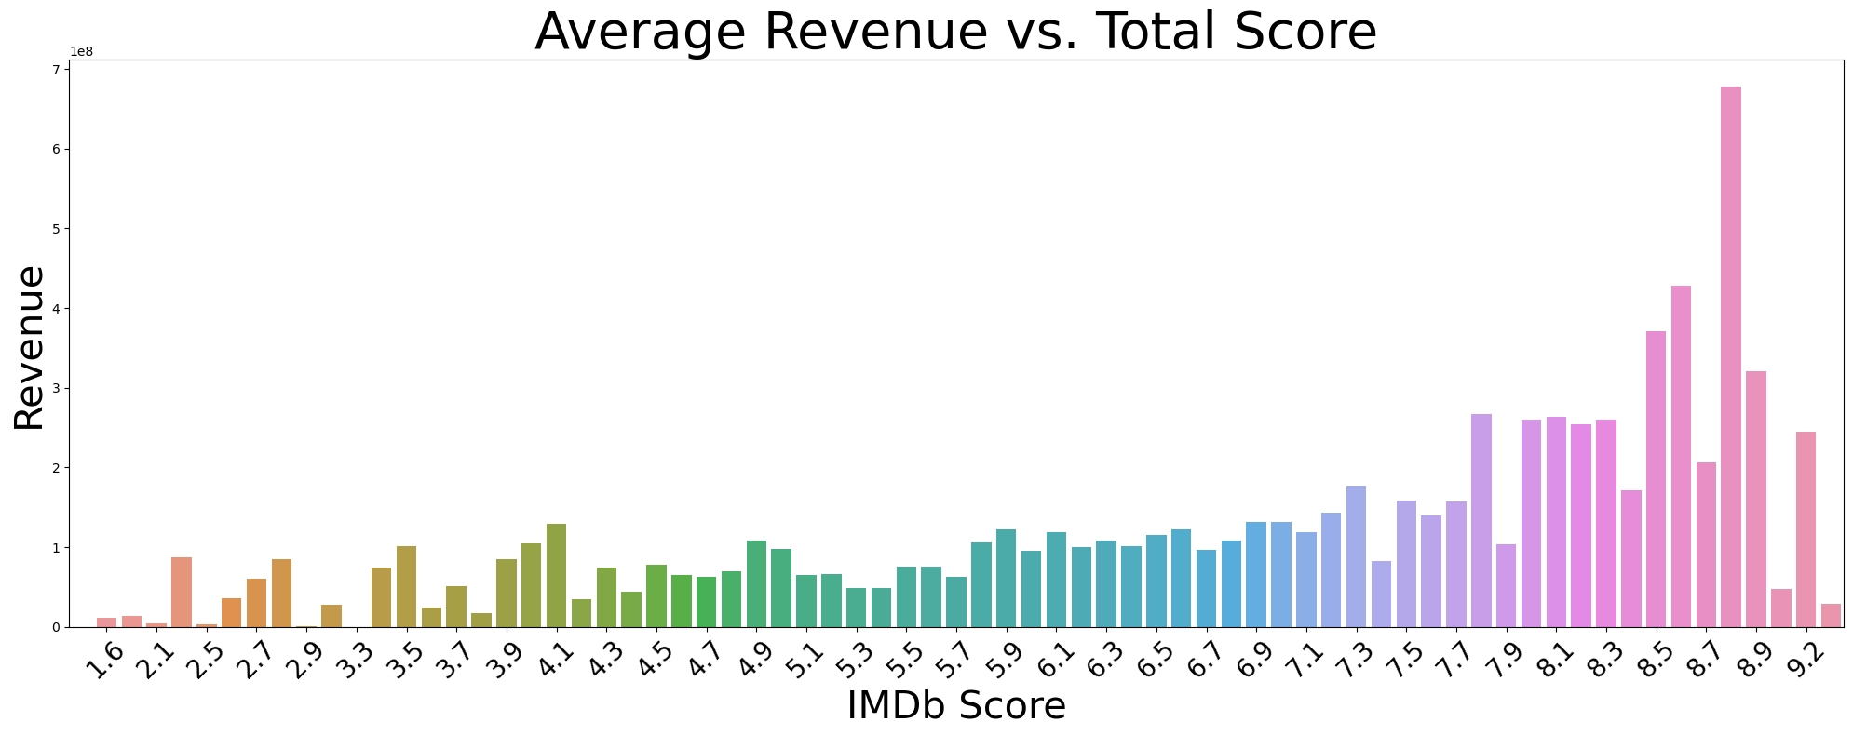
Q10: How Does Revenue Vary with IMDb Scores?
Insight: IMDb Scores and Revenue
Key Observation:
Average revenue increases with higher IMDb scores, with a notable surge for scores above 8.
Trend:
Critically acclaimed movies tend to achieve greater financial success.
Variability:
Lower-rated movies show revenue variability, influenced by factors like franchise value, production scale, and marketing.
Conclusion:
Both movie quality and external factors play critical roles in determining box office performance.

Slide 18
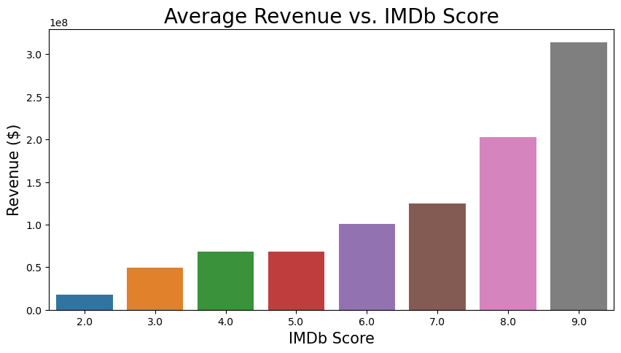
Q11. Revenue Variation Across IMDb Score Categories?
Insight: Revenue Across IMDb Score Categories
Key Observation:
Movies with higher IMDb scores (9.0+) yield the highest revenue, demonstrating a strong link between critical acclaim and financial success.
Trend:
Revenue gradually increases across scores, with movies rated 7.0+ showing substantial financial gains.
Conclusion:
Achieving even moderately high ratings can significantly boost commercial success, highlighting the value of quality production and audience engagement.

Slide 19
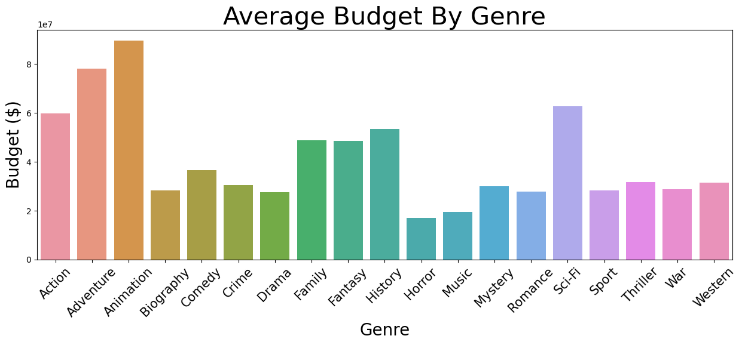
Q12: How does the budget vary across genres?
Insight: Budget Trends Across Genres
Key Observation:
Animation, Adventure, and Sci-Fi have the highest average budgets, driven by special effects and large-scale production demands.
Contrasting Genres:
Horror, Biography, and Comedy require smaller budgets due to simpler production setups and minimal special effects.
Conclusion:
Genre-specific production needs significantly influence budget allocation, offering valuable insights for strategic financial planning in the film industry.

Slide 20
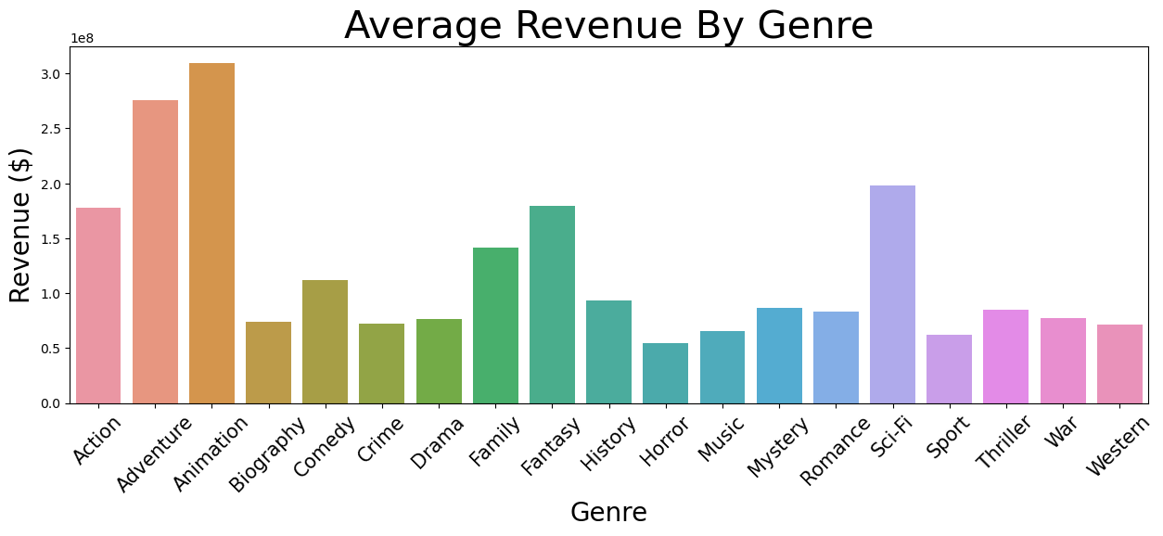
Q13: How does the revenue vary across genres?
Insight: Revenue Trends Across Genres
Key Observation:
Animation, Adventure, and Sci-Fi generate the highest average revenue, driven by global appeal, franchises, and high production values.
Contrasting Genres:
Biography, Horror, and Western yield lower revenue, reflecting niche or regional audiences.
Conclusion:
Certain genres hold greater financial potential, offering valuable guidance for producers and investors targeting global markets.

Slide 21
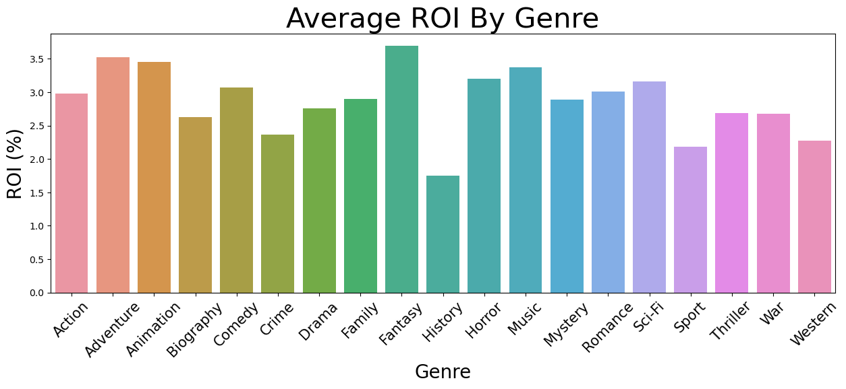
Q14: ROI Variation Across Genres
Insight: ROI Trends Across Genres
Key Observation:
Fantasy, Horror, and Animation deliver the highest average ROI, showcasing significant profitability relative to production costs.
Contrasting Genres:
History and War have lower ROIs, reflecting high production costs with less proportional returns.
Conclusion:
For maximum profitability, producers and investors should prioritize genres with high ROI potential while aligning with creative objectives.

Slide 22
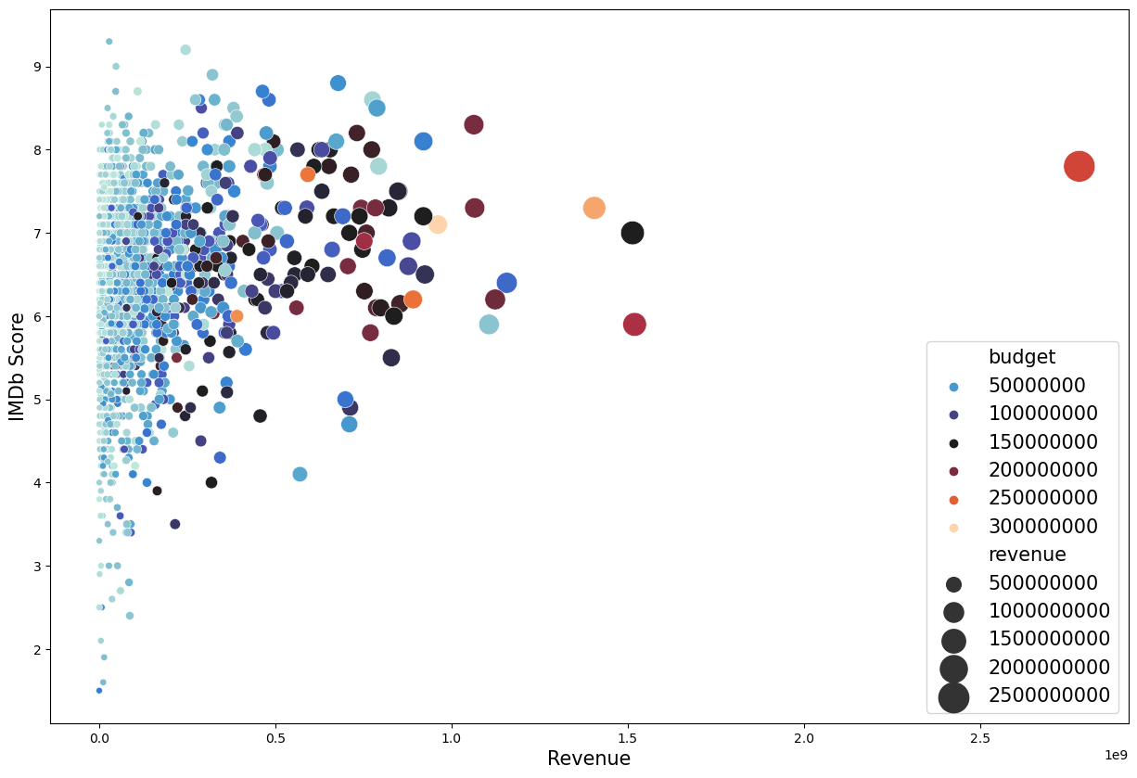
Q15: What is the relationship Between IMDb Scores, Revenue, and Budget?
Key Observation:
A weak positive correlation exists between IMDb scores and revenue, with higher-rated movies often earning more, but exceptions persist.
Budget Influence:
Larger budget movies cluster around higher revenues and IMDb scores, reflecting the impact of financial resources on quality and reach.
Some low-budget films also achieve success through creative storytelling and niche appeal.
Conclusion:
While budgets enhance market potential, innovative filmmaking can also drive revenue and critical success.

Slide 23
Machine Learning Techniques for Cinema Insights
Objectives:
Analyze and predict movie success based on structured IMDb data.
Utilize advanced machine learning techniques to uncover insights.
Data Preparation:
Frameworks Used:
PySpark for data handling and preprocessing.
Pandas and Scikit-learn for analysis and modeling.

Slide 24
Machine Learning Techniques for Cinema Insights
Preprocessing Steps:
Data loaded from Google Cloud Storage.
Missing values filtered systematically (e.g., genres, runtime).
Categorical variables converted using one-hot encoding.
Feature Engineering:
Features like genre, runtime, popularity, director/actor scores, and sentiment extracted.
Revenue used as the target variable for prediction.

Slide 25
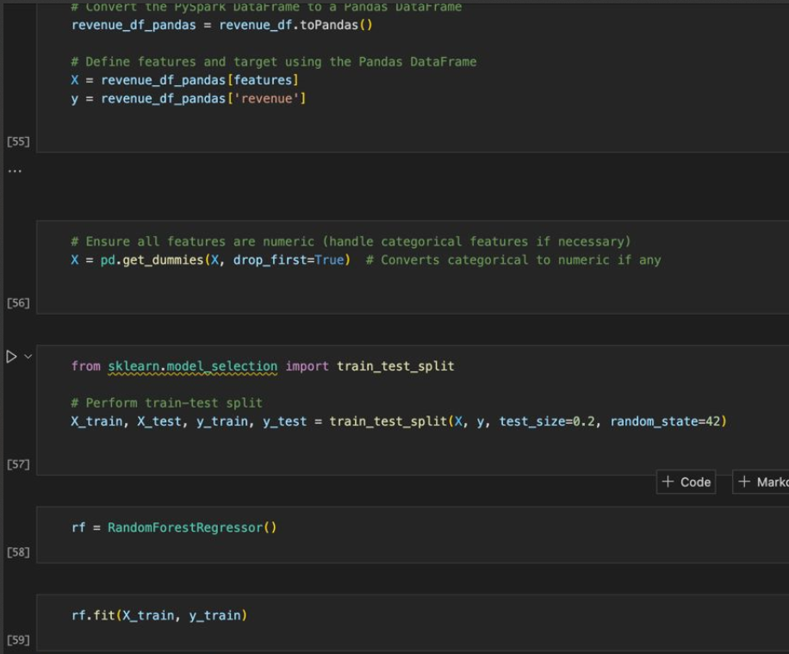
Machine Learning Techniques for Cinema Insights
Machine Learning Models
Random Forest
Why Random Forest:
Captures complex relationships between features.
Robust against overfitting with ensemble learning.
Implementation:
Defined features and revenue target.
Data split into training (80%) and testing (20%) sets.
Model trained and evaluated using:
Root Mean Square Error (RMSE).
Cross-validation scores.
Insights:
Genres, director scores, and sentiment were significant predictors.
RMSE demonstrated strong predictive performance.

Slide 26
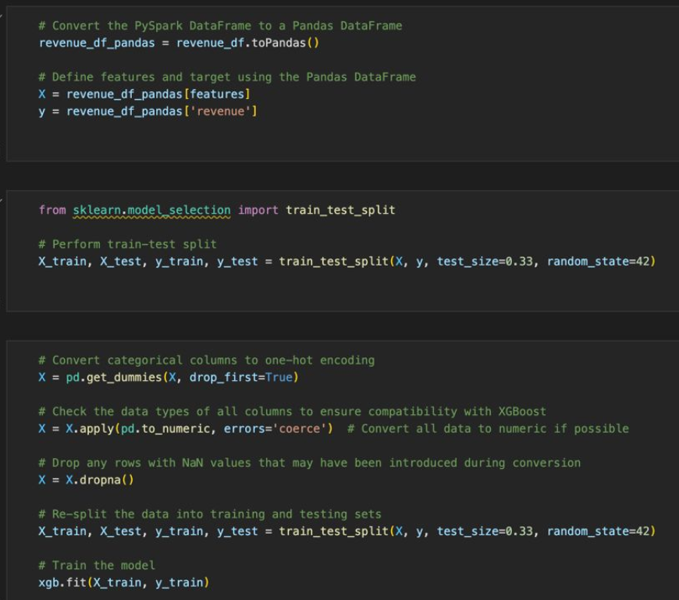
Machine Learning Techniques for Cinema Insights
Machine Learning Models
XGBoost
Why XGBoost:
High accuracy and efficiency for structured datasets.
Handles missing data effectively.
Implementation:
Similar feature set and target as Random Forest.
Preprocessed data with one-hot encoding for categorical variables.
Performance metrics:
Training and testing scores.
Comparison with baseline predictions.
Insights:
Popularity metrics and crew attributes aligned well with revenue predictions.
Model highlighted nuanced audience preferences.

Slide 27
Machine Learning Techniques for Cinema Insights
Results and Implications
Key Findings:
Runtime and genres significantly impact movie success.
Sentiment analysis aligns with ratings, offering both quantitative and qualitative insights.
Director and actor popularity correlate with profitability.
Strategic Implications:
Producers can predict audience reception before release.
Marketers can tailor campaigns based on predicted popularity.

Slide 28
Challenges
Data Quality:
Missing values in critical fields like runtime and crew details.
High Dimensionality:
Increased computational cost with categorical features.
Complexity in Text Analysis:
Sentiment analysis limited by missing and inconsistent review data.

Slide 29
Conclusion
Key Takeaways
Genres, runtime, and cast significantly impact movie success.
Machine learning models provide actionable insights for strategic decisions.
Budget and creative talent drive critical and commercial outcomes.
Future Potential
Enhance with advanced NLP for sentiment analysis.
Improve data quality for more robust predictions.
Explore causal relationships beyond correlations.

Slide 30


